Slide 1
The Net who Cried Hyrax
Real Time Rock Hyrax detection and classification
Using Keras and TensorFlow
Oded Kalev, Noa Simon, Noa Rahamim

Slide 2
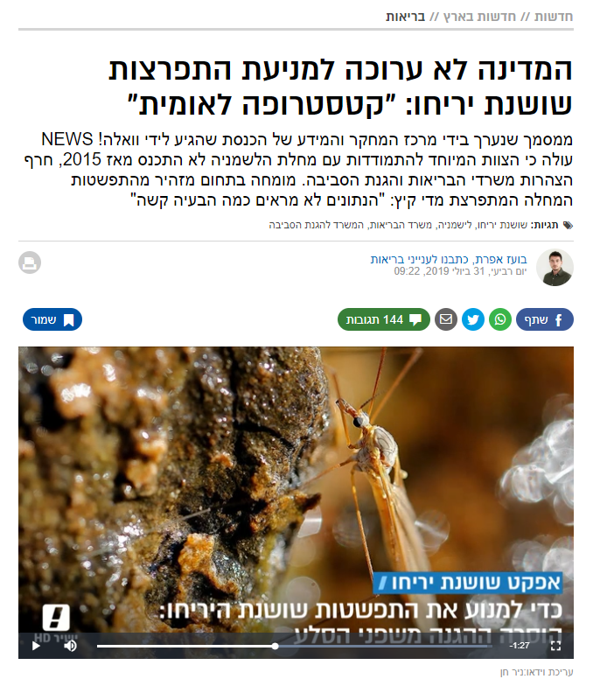
אודותינו
Rock Hyraxes are main carriers of Leishmania
Phlebotomus pass this disease to humans
Efforts are made to prevent disease spread by distancing the Phlebotomus and the Rock Hyraxes from human living areas

Slide 3




Data acquisition
Building a data set turned out to be a non-trivial task
Google Images
YouTube Videos
Videos We Filmed
Filtering
Break to frames,
Tag
Film,
Break to frames,
Tag
Labels for classification and detection

Slide 4
detection
Detection
TensorFlow ObjectDetectionAPI
Using SSD mobileNetV1 pre trained on COCO dataset
It was more than we needed…

Slide 5
classification
Keras implementation of InceptionV3
Pre trained on ImageNet
Balanced data, between and within labels
Future improvements

Slide 6
Questions?
Oded Kalev, Noa Simon, Noa Rahamim

